Slide 1


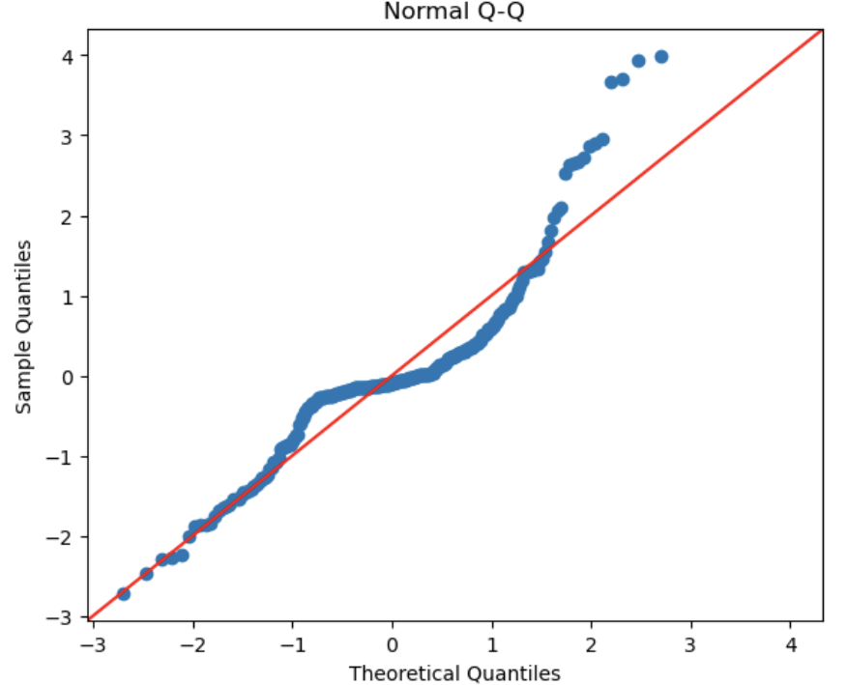
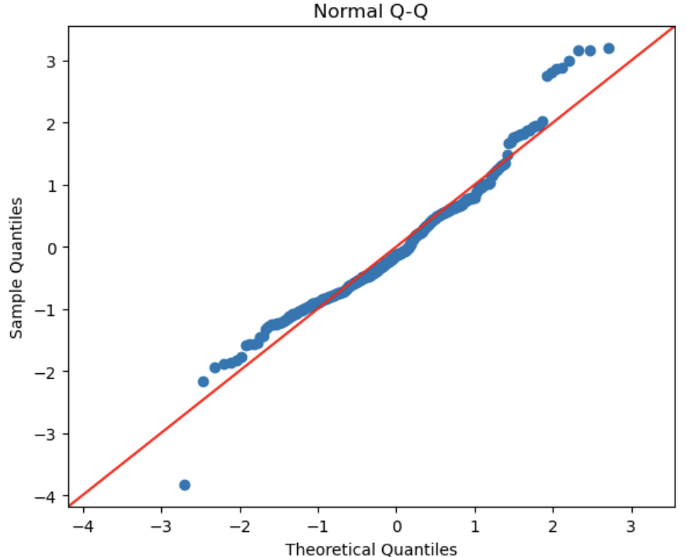
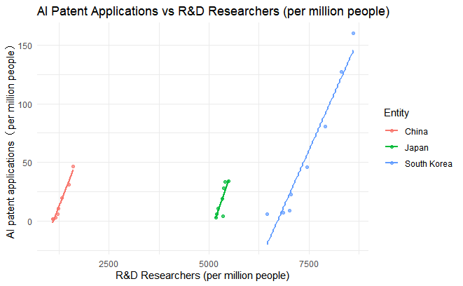
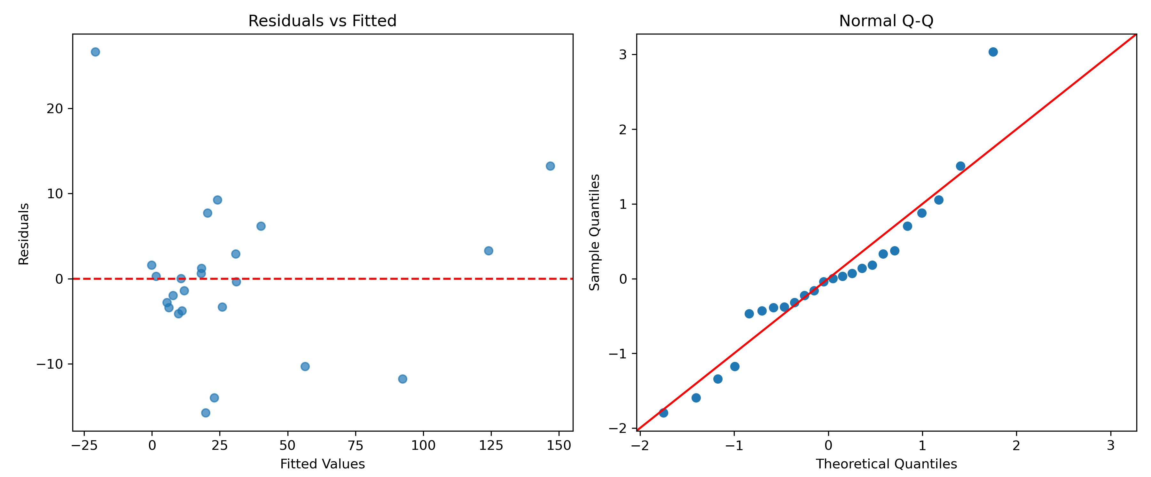
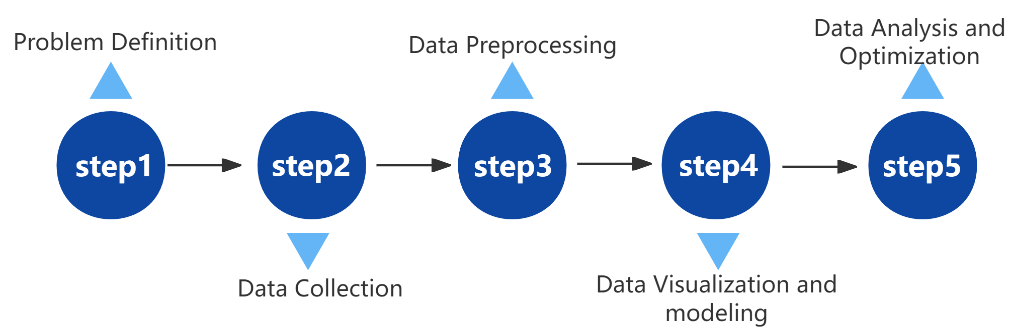
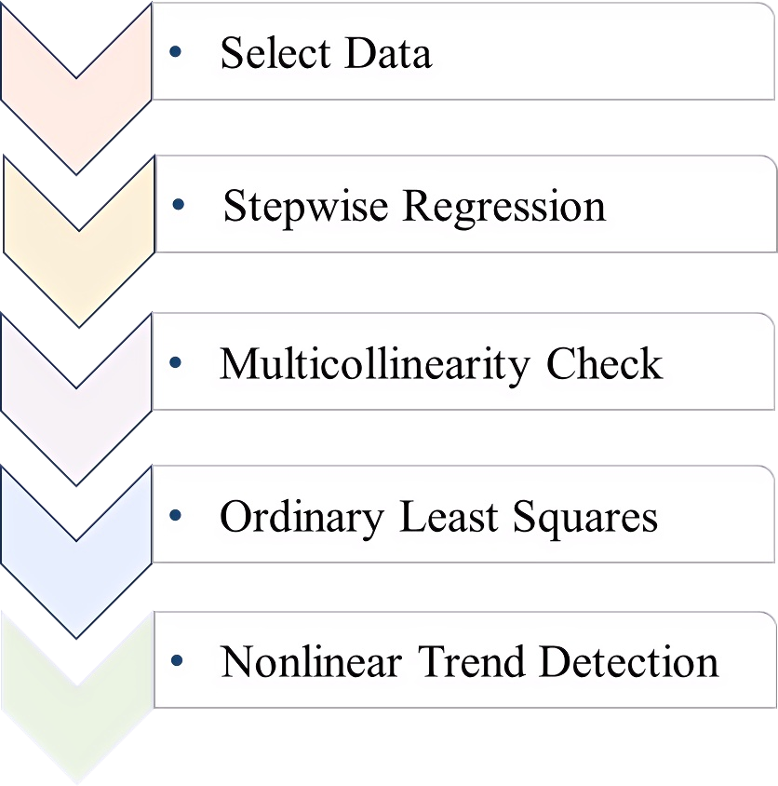
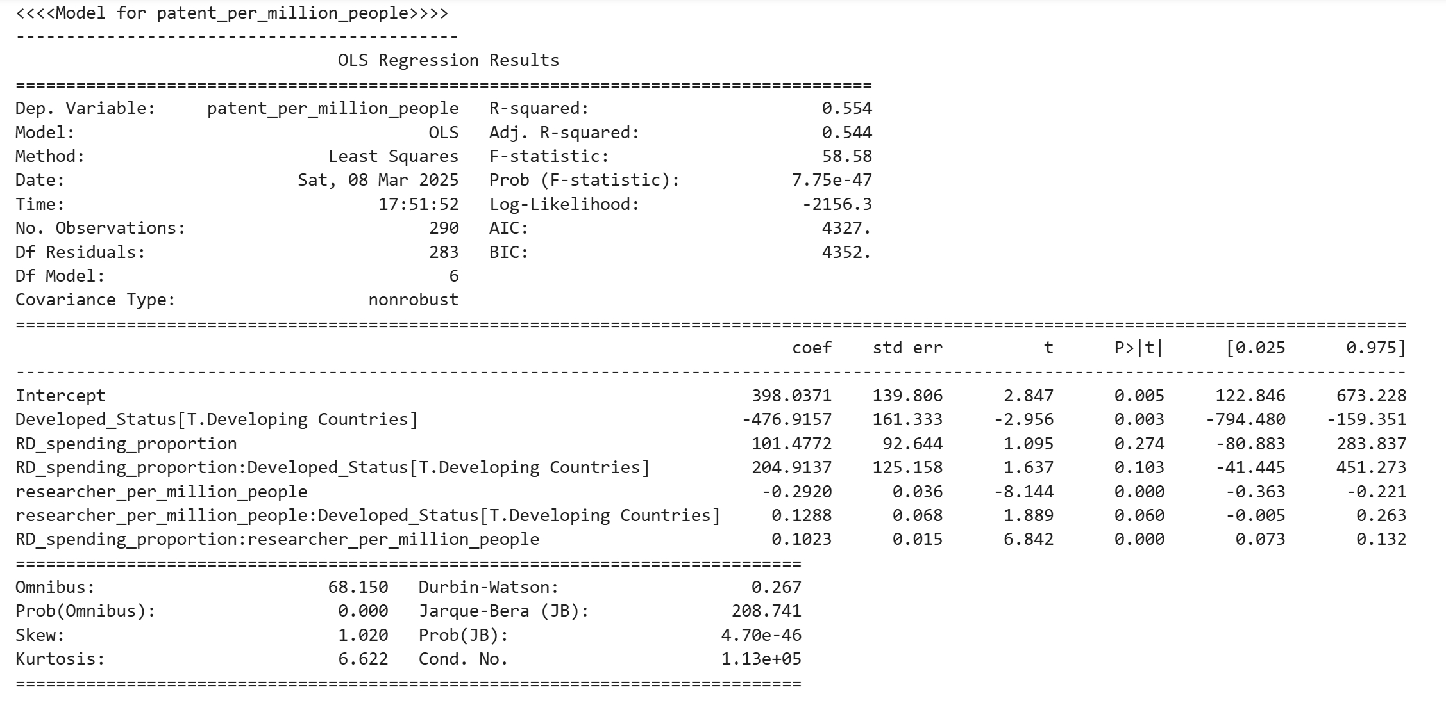
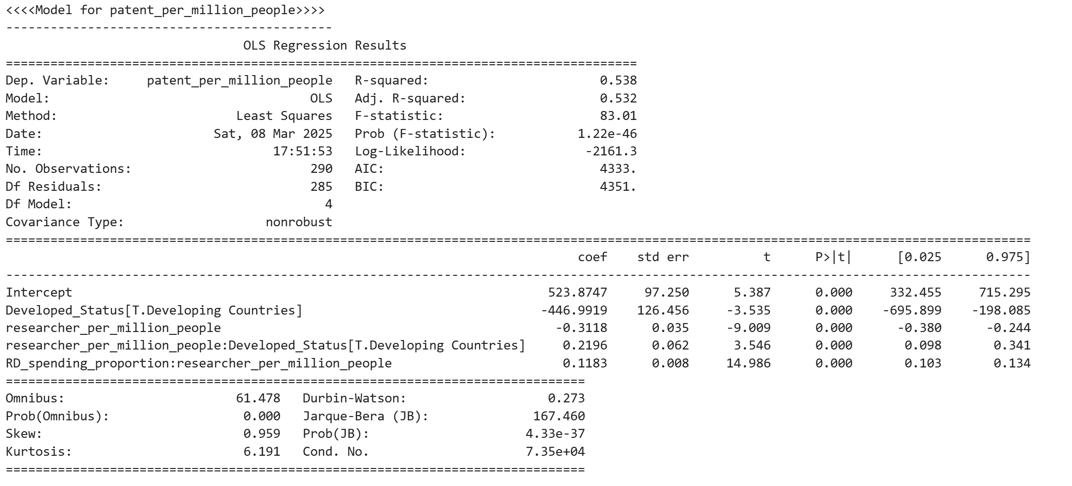

Global R&D Investment and Innovation Output Analysis
Group Members: Chaoyu Han, Kaiqi Zhang, Jiateng Yang, Manyi Yang, Yizhou Gu
1.Introduction
3.Data Analysis
Innovation and technological change are fundamental drivers of economic growth and societal progress. As economies become increasingly knowledge-based, research and development (R&D) investment plays a crucial role in shaping technological advancements, fostering industrial competitiveness, and driving innovation-led growth.
Q1.Does R&D investment in East Asian countries have a significant impact on patent applications related to AI?
$$Model:{patent_ai_per_million_people}=β_{0}+β_{\begin{aligned}1 \\ \end{aligned}}∗researcher+β_{2}∗Entity+ε$$
2.Methodology
a)Model Robustness and Statistical Significance: This regression model uses OLS to analyze the impact of R&D investment on patent applications, with log transformation applied to improve model robustness.
b)Residual Analysis and Model Optimization: The original data exhibits heteroscedasticity, but after log transformation, residual normality improves, error variance stabilizes, and the validity of regression assumptions is enhanced. Additionally, the AIC decreases to 886.8, indicating that the optimized model has stronger explanatory power.
a) Data Selection & Processing
(Data sources: Our World in Data, the World Bank, and the UNESCO Institute for Statistics. It covers a national-level dataset on R&D from 2013 to 2020.)
The scatter plot shows a positive correlation between R&D investment and AI patent applications in East Asia. South Korea's AI patent growth is the most pronounced, with a steeper trend in R&D researcher density compared to China and Japan. This suggests higher R&D efficiency, where the same investment yields more AI patents.
Q2.How does R&D investment affect patent applications and articles published in scientific and technical journals in different countries?
4.Conclusion
$$Model:{patent_per_million_people}=β_{0}+β_{1}∗researcher+β_{2}∗researcher:Developed_Status+β_{3}∗RD_spending_proportion:researcher+β_{4}∗Developed_Status+ε$$
The results show a positive correlation between R&D spending and innovation output, with South Korea demonstrating the highest R&D efficiency. Regression analysis confirms that R&D spending (p < 0.001) significantly boosts patent applications, while researcher density's effect varies by economic classification. The log-transformed model improves explanatory power and ensures better residual normality and variance stability, validating the regression assumptions.
b) Approach
The optimal variables were selected based on AIC feature stepwise regression. Through VIF, OLS regression was performed and LOWESS was used to nonlinear smooth the number of inputs and patent applications.
5.Reference
https://ourworldindata.org/research-and-development

